Slide 1
Assistive tool for Visually Impaired using Deep Learning
Aditya 2019UCO1557
Rupesh 2019UCO1547
Harmeet 2019UCO1515
Sumit 2019UCO1548

Slide 2
Introduction
The objective of this project is to create a computer vision model which detects lanes, objects and obstacles in a person’s path that assists him/her in navigation.
The task on hand can be subdivided into the following tasks:
Object localization → Implemented already
Lane Detection → Implemented already
Depth Estimation
Navigation
Adding voice control using NLP ( Natural Language Processing )
Mobile Application
Notes:
Harmeet

Slide 3
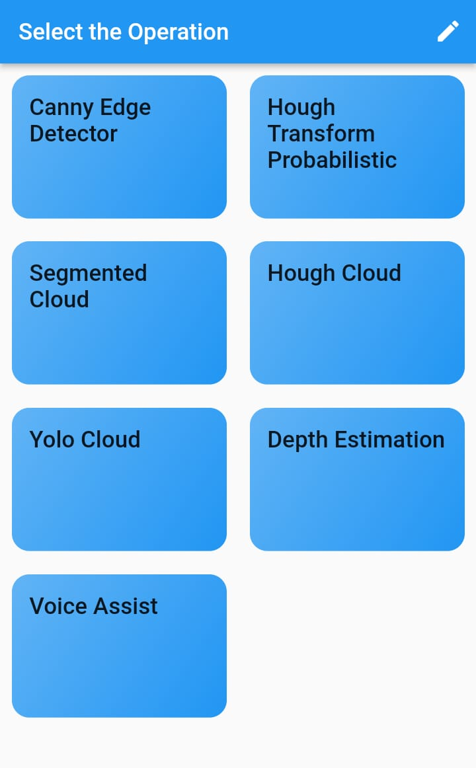
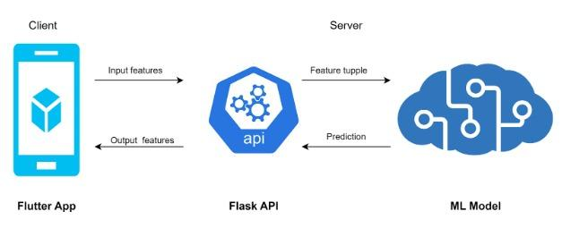
Technical Working of The Project - Architecture
The prototype is a mixture of -
Cloud computing
Edge computing
Tasks which can be computed with less computation power are executed on edge and computation intensive tasks are on cloud.
This architecture requires an API which connects flutter app and the ML model deployed in cloud.
Notes:
Rupesh

Slide 4
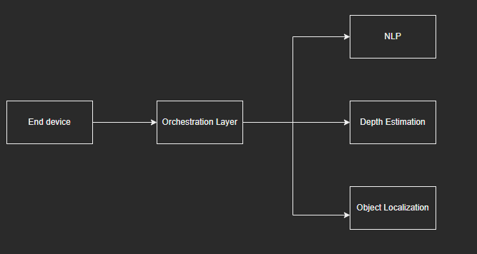
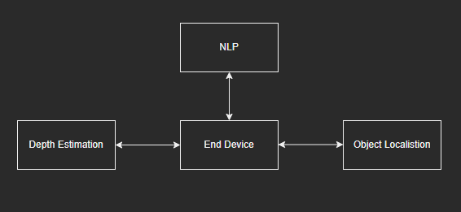
Technical Working of The Project - Architecture
Recursive Querying
Iterative Querying
We are planning to use this architecture for our prototype
Notes:
Rupesh

Slide 5
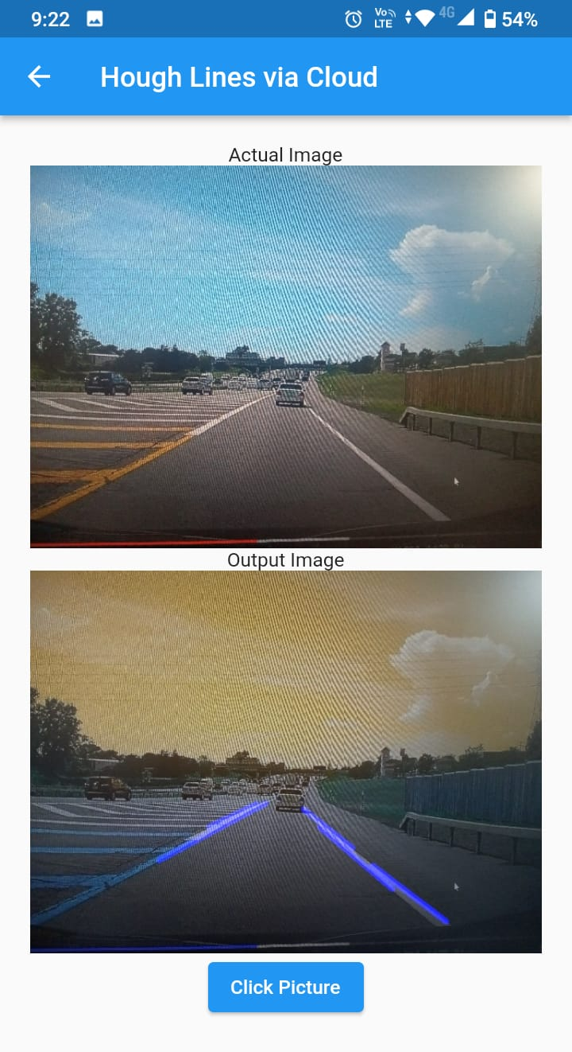
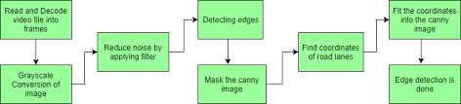
Technical Working of The Project - Lane Detection
We used “ Flutter OpenCV ” library on the application to achieve Lane Detection on Edge Computing Level.
The library offered basic operations such as Gaussian Blur, Image Segmentation and Hough Transform which helps us achieve Lane Detection successfully.
Steps of Lane Detection
Notes:
Rupesh

Slide 6
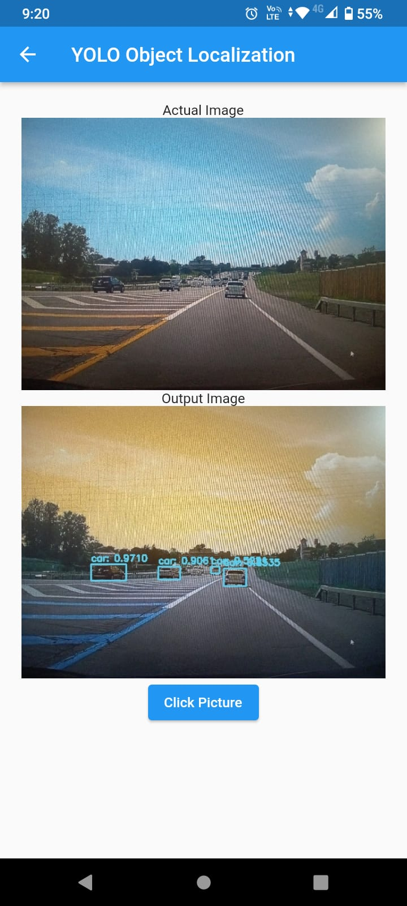
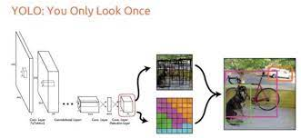
Technical Working of The Project - Object Localization
For Object Localization, we used YOLO Algorithm as compared to SSD Algorithm as it was more faster and accurate in detecting smaller objects.
So, we made a Flask API which supports YOLO operation.
Notes:
Rupesh

Slide 7
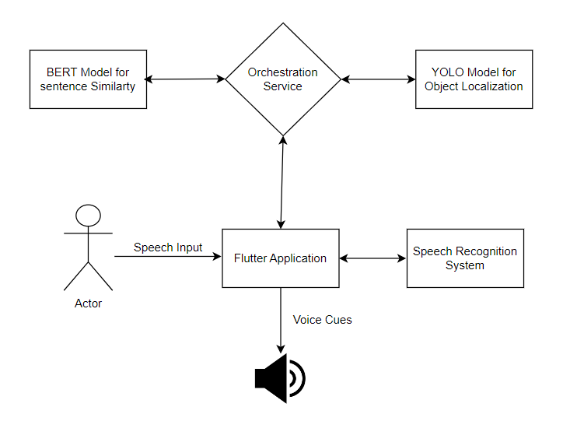
Integration with the app

Slide 8
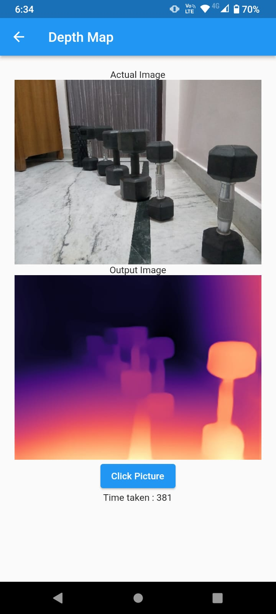
Technical Working of The Project - Depth Estimation
We have implemented the paper titled ‘Towards Robust Monocular Depth Estimation: Mixing Datasets for Zero-shot Cross-dataset Transfer’. The architecture of the CNN was predefined and the code is written in python using the pytorch library.
We took some pre-trained weights that were of the task of image segmentation and retrained them on the KITTI dataset.
The output matrix gives the intensities relative to the distance from the camera which could be finally used to tell if a bounding box is too close from the user.
Depth mask and object localization results will be combined at the orchestration layer to get a final output.
The bounding boxes and depth map can be used to pinpoint the location of different objects and their relative distance from the visually impaired person.
Notes:
Rupesh

Slide 9
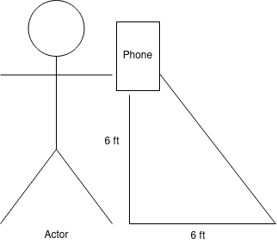
Integration with the app
We first used the CNN model to get a depth map of the image. Now the problem with the depth map is that it only gives a relative distance. Our workaround : On the pixel intensity of that matrix, we fix the last row’s intensity as being proportional to the distance to the floor as we intend the user to focus a bit towards the ground.
We then use the formula to find the approximate distance using the depth map generated by the CNN
Distance of point k from user = (Distance of floor from user Intensity at floor point in the depth map)* 2.5863 metres
Notes:
Rupesh

Slide 10
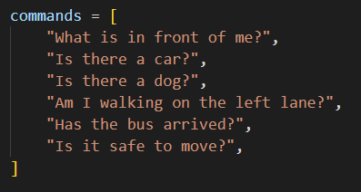

Technical Working of The Project - NLP
A set of predefined commands is decided. These commands will trigger a subroutine and return the desired output.
Speech to text recognition occurs Edge.
The text is sent to a NLP model deployed on cloud to get the most similar command.
The NLP model used BERT model. Last hidden state tensors are evaluated for all commands.
These tensors are then mean pooled and similarity is calculated using cosine similarity.

Slide 11
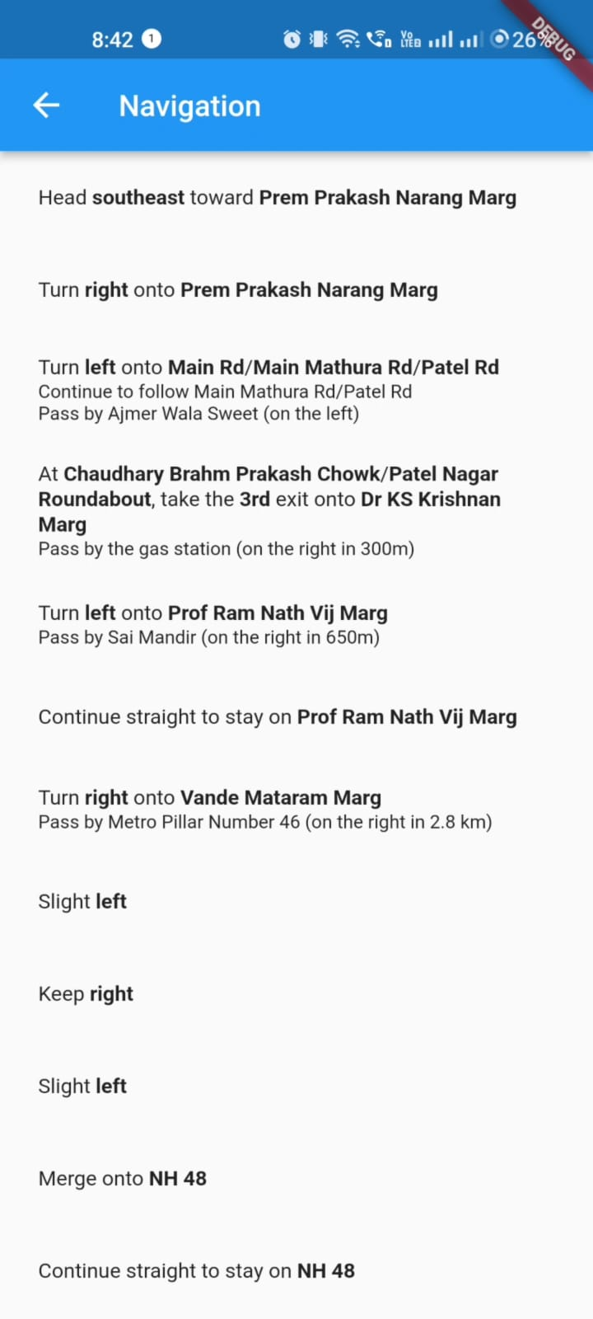
Technical Working of The Project - Navigation
We integrated the Google Maps API into our application, we first obtained an API key from the Google Cloud Console. We then added the necessary dependencies to our Flutter project and used the API to provide directions to the users.
The users can input their destination using voice commands, which are converted to text using speech-to-text technology. The app then sends the destination information to the Google Maps API, which provides a route to the destination. The directions are presented to the user using audio feedback, providing step-by-step guidance to reach their desired location.

Slide 12
Technical Working of The Project - Flutter App
Multi-threading was considered while building the application because we have 2 two types of actions that can occur simultaneously. This would make app faster but might cause race condition between threads and in the worst case even a deadlock. Therefore we implemented the operations on a single thread itself by utilizing event loop in a efficient manner.
Example workflow :
User gives a Voice command - ‘What is in front of me?’.
The Speech recognition module converts the command to text.
The Camera module captures an image simultaneously.
The text command and image is then sent to the flask API.
The Flask API then sends the text to the BERT based Sentence Similarity module to identify the command type.
After identifying the command, in this case ‘User wants to know what in its vision’, the Flask API will first call the Yolo algorithm.
The Flask API then calls the Depth Estimation service.
A procedure is executed which maps the bounding boxes of Yolo and Depth map of Depth Estimation to identify the precise location of objects.
The output to be given to the user is formulated and returned back to Flutter.
Flutter upon receiving the text based message, calls the Text to speech service to intimate the user.

Slide 13
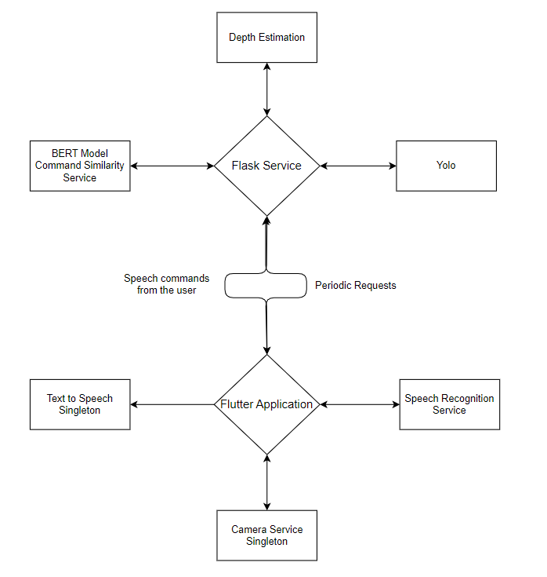

Slide 14
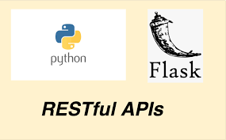
Technical Working of The Project - FLASK Server
The Flask API uses POST Endpoints to interact with Frontend.
The endpoints currently supported are:
“/raahi/canny”
“/raahi/hough”
“/raahi/yolo”
“/raahi/segmented”
“/raahi/depth_estimation”
“/raahi/voice-assistance”
“/raahi/automatic”
“Flask-Restful” Extension was used to build the API which provides minimal setups to create easy RESTful Web Services.
Notes:
Rupesh

Slide 15
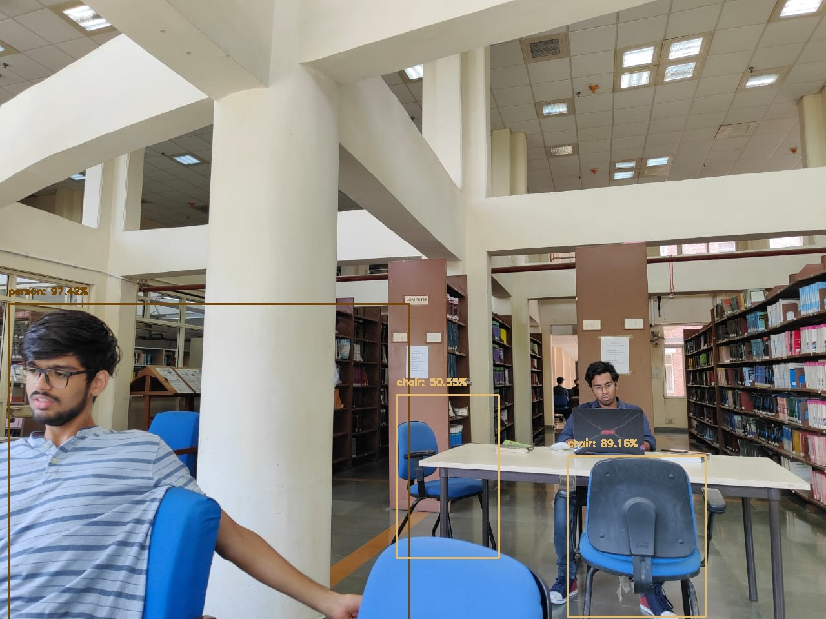
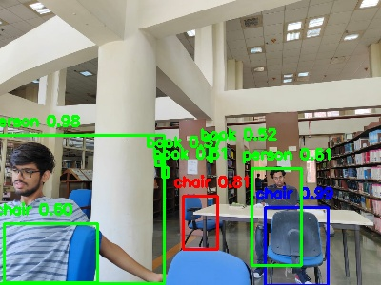
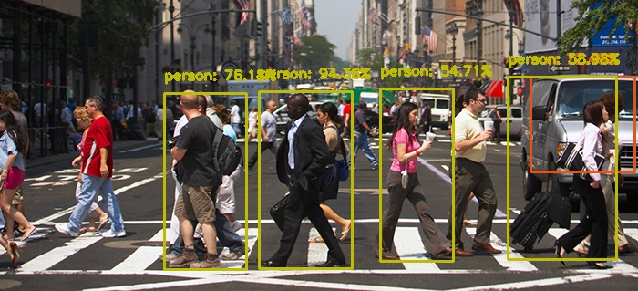
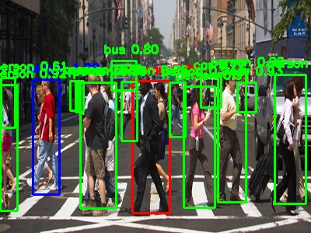
Result and Experiments
Object Localization Models
SSD
YOLO

Slide 16
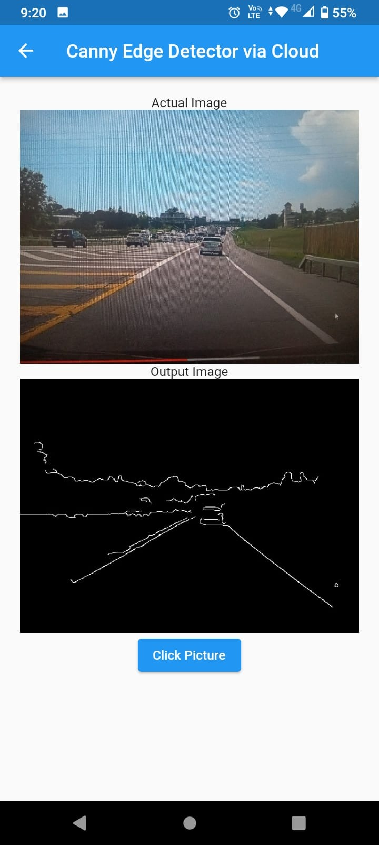
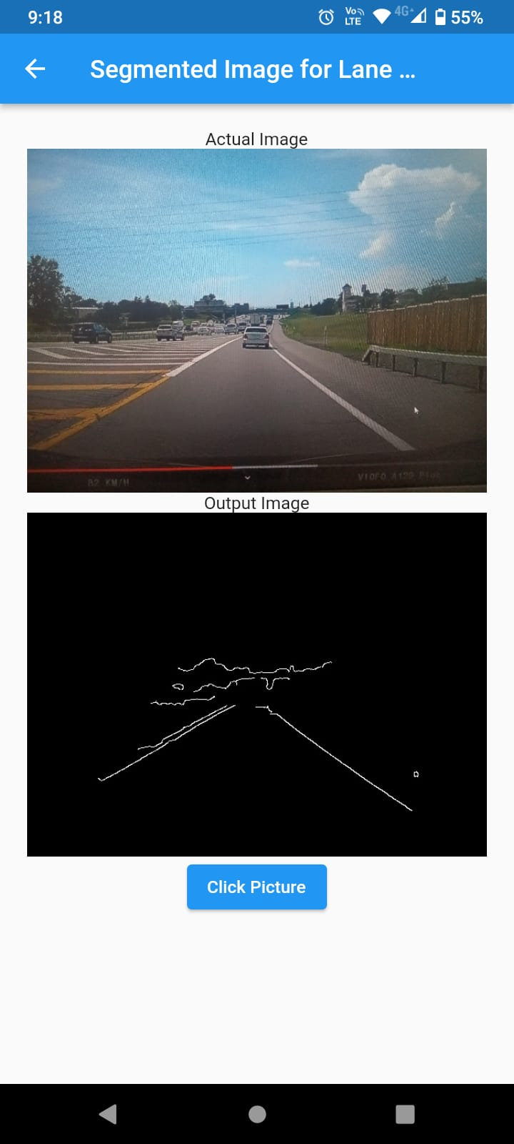
Result and Experiments : Lane Detection

Slide 17
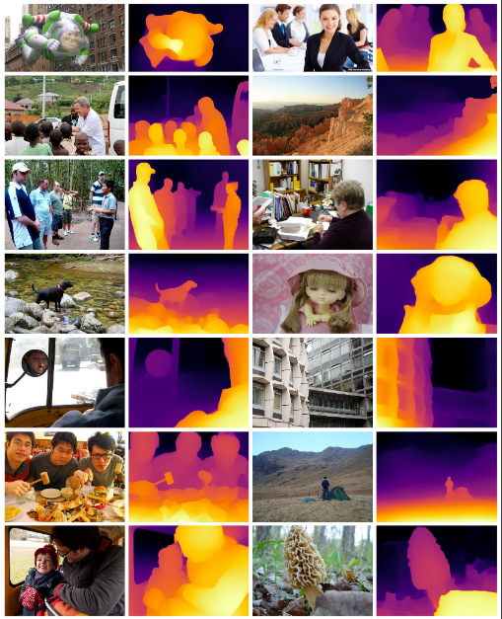
Result and Experiments : Depth Estimation

Slide 18
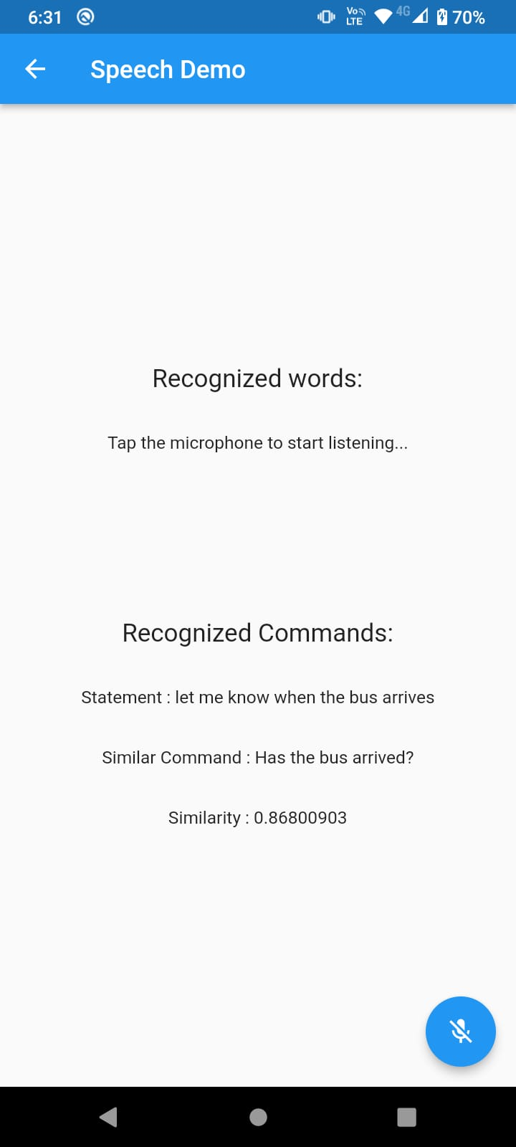


Result and Experiments : Voice assistant

Slide 19
Contribution of Team Members
Team Members | Task
Aditya Kumar | Depth Estimation implementation, Navigation
Rupesh Kumar | NLP Model
Harmeet Singh | Flutter Prototype
Sumit Yadav | Flask API

Slide 20
Challenges faced
Package compatibility:
Compatibility issues while building Flutter Application
Slow computation due to lack of GPUs
Potential Single point of failure due to Orchestration layer
The result of Depth Estimation sometimes tend to be relative rather than giving absolute depth.

Slide 21
References
Ramaiah, N. S. (2019). IoT Based Route Assistance for Visually Challenged.
Abdel-Jaber, H., Albazar, H., Abdel-Wahab, A., El Amir, M., Alqahtani, A., & Alobaid, M. (2021). Mobile Based IoT Solution for Helping Visual Impairment Users. Advances in Internet of Things, 11(4), 141-152.
Redmon, J., Divvala, S., Girshick, R., & Farhadi, A. (2016). You only look once: Unified, real-time object detection. In Proceedings of the IEEE conference on computer vision and pattern recognition (pp. 779-788).
Ranftl, R., Lasinger, K., Hafner, D., Schindler, K., & Koltun, V. (2020). Towards robust monocular depth estimation: Mixing datasets for zero-shot cross-dataset transfer. IEEE transactions on pattern analysis and machine intelligence, 44(3), 1623-1637.
Chen, W., Fu, Z., Yang, D., & Deng, J. (2016). Single-image depth perception in the wild. Advances in neural information processing systems, 29.
Reimers, N., & Gurevych, I. (2019). Sentence-bert: Sentence embeddings using siamese bert-networks. arXiv preprint arXiv:1908.10084.
D. Jurafsky, J. H. Martin, P. Norvig, and S. J. Russell, Speech and language processing: an introduction to natural language processing, computational linguistics, and speech recognition, Second Edition, Pearson International Edition. Upper Saddle River, NJ: Prentice Hall, Pearson Education International, 2009.

Slide 22
Thanks

